Slide 1







MES Wadia College of Engineering, Pune 01.
Seminar Cyber Security
Study and Analysis of Web Application Firewall
-Protecting Web Applications in the Digital Age
Seminar Guide :
Prof. S. K. Wagh
- Ayush Acharya TE 1 Roll No. 35

Slide 2
TABLE OF CONTENTS
Introduction
Literature Survey
Motivation
Methodology
Applications
Advantages & Disadvantages
Conclusion
References
01
03
12
13
28
29
31
32

Slide 3

INTRODUCTION
The aim of the firewall is to protect the premises network from Internet based attacks and to provide a single choke point where security can be imposed.
The firewall, then, provides an additional layer of defense, insulating the internal systems from external networks.
The Web Application Firewall (WAF) is a security solution designed to protect web applications by filtering and monitoring incoming web traffic.
It safeguards web applications from a wide range of online threats, prevent data breaches, maintain user trust.

Slide 4
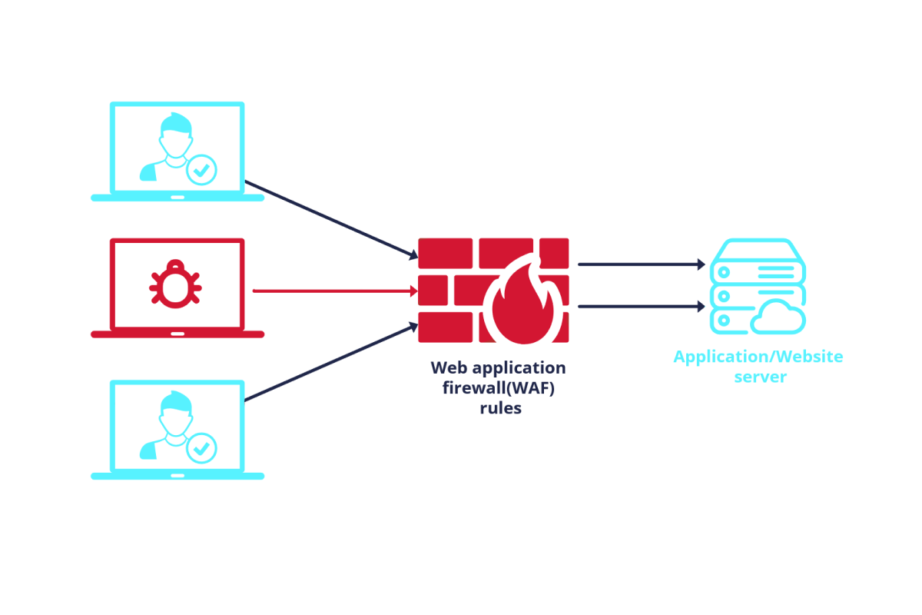
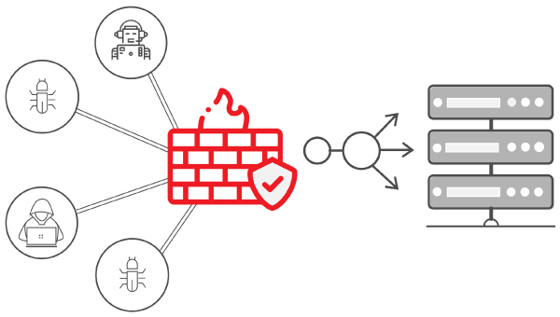
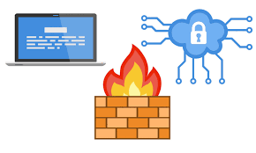

Slide 5
Literature Survey
Sr.No | Title | Journal Name | Year Of Publication | Remarks
1. | A critical review of the techniques used for anomaly detection of HTTP-based attacks: taxonomy, limitations and open challenges | Elsevier Journal Volume : Computer and Security 124 102997 Authors: Jesus E. Verdiogo, Rafael Alonso , Antonio Alonso, German Madinabeitia | 2023 | Introduces a new framework for detecting HTTP-based attack anomalies, addresses literature challenges, and underscores the need for standardized datasets, robust methods, and metrics. Emphasizes scaling and obsolescence concerns in real web service applications.

Slide 6
Literature Survey
Sr.No | Title | Journal Name | Year Of Publication | Remarks
2. | A deep learning assisted personalized deception system for countering web application attacks | Elsevier Journal Volume : Information Security and Applications 67 103169 Authors: Waleed Shahid, Baber Aslam, Haider Abbas, Hammad Afzal, Saad Khalid | 2022 | Proposes a high interaction web deception system assisted by deep learning-based attack detection and cookie analysis. Offers real-time attacker profiling, session management, with various web attacks. Emphasizes scalability, efficiency, and support for IoT networks..

Slide 7
Literature Survey
Sr.No | Title | Journal Name | Year Of Publication | Remarks
3. | An enhanced deep learning based framework for web attacks detection, mitigation and attacker profiling | Elsevier Journal Volume : Networks and Computer Applications 198 103270 Authors: Waleed Shahid, Baber Aslam, Haider Abbas, Hammad Afzal, Saad Khalid | 2022 | Proposes a hybrid framework combining deep learning and cookie analysis for real-time web attack detection and mitigation. It efficiently profiles attackers, saving processing resources. Offers protection against a wide variety of web attacks, including POST requests.

Slide 8
Literature Survey
Sr.No | Title | Journal Name | Year Of Publication | Remarks
4. | DNS Intrusion Detection (DID) — A SNORT-based solution to detect DNS Amplification and DNS Tunneling attacks | Elsevier Journal Volume : Franklin Open 2 100010 Authors: Sanjay Adiwal, Balaji Rajendran, Pushparaj Shetty, Sithu Sudarsan | 2023 | Introduces DID, integrated with SNORT, to detect DNS attacks, including amplification and tunneling. System utilizes novel IDS signatures to identify empirical DNS attacks, exhibiting high detection and low false-positive rates. Emphasizes effectiveness of DID in classifying DNS attacks.

Slide 9
Literature Survey
Sr.No | Title | Journal Name | Year Of Publication | Remarks
5. | Dynamic Web Application Firewall detection supported by Cyber Mimic Defense approach. | Elsevier Journal Volume : Networks and Computer Applications 213 103596 Authors: Mariusz Sepczuk | 2023 | Introduces a concept to enhance WAF with Cyber Mimic Defense, improving detection of unknown attacks. Experiments show increased detection and dynamic rule creation for WAF. Reduces malicious web traffic, adds unpredictability for attackers,& enhances detection beyond traditional firewalls.

Slide 10
Literature Survey
Sr.No | Title | Journal Name | Year Of Publication | Remarks
6. | HTTP request pattern based signatures for early application layer DDoS detection: A firewall agnostic approach | Elsevier Journal Volume : Information Security and Applications 65 103090 Authors: Amit Praseed, P. Santhi Thilagam | 2022 | Introduces an Early Detection Module (EDM) for Application Layer DDoS attacks using HTTP request patterns as signatures. Employs Sample Entropy for improved detection of temporal similarity. EDM reduces detection latency for AL-DDoS attacks, addressing a critical challenge in web security.

Slide 11
Literature Survey
Sr.No | Title | Journal Name | Year Of Publication | Remarks
7. | Hybrid unsupervised web-attack detection and classification – A deep learning approach. | Elsevier Journal Volume : Computers Standards & Interfaces 86 103738 Authors: Seema Pillai, Dr. Anurag Sharma | 2023 | Introduces a novel approach combining unsupervised deep learning for web attack detection with a DBM-BiLSTM-based model for classification. Achieves impressive results with high accuracy, F1-Score, of 97.62. Outperforms existing techniques in protecting web applications from attacks.

Slide 12
Literature Survey
Sr.No | Title | Journal Name | Year Of Publication | Remarks
8. | Software-defined network-based HTTP flooding attack defender. | Elsevier Journal Volume : Computers & Electrical Engg. 101 108019 Authors: Reeza Mohammadi, Chaggan Lal, Mauro Conti, Lokesh Sharma | 2022 | Introduces SHFD, a SDN based defender against HTTP flooding attacks. Demonstrates a 13% improvement in detection time and a 29% increase in blocked malicious flows compared to existing approaches. SDN's dynamic configuration is harnessed to mitigate HTTP flooding, effectively countering DDoS attack.

Slide 13
Literature Survey
Sr.No | Title | Journal Name | Year Of Publication | Remarks
9. | Study of Web Application Firewalls (WAFs) | IIT KG Project Paper Authors: Namit Gupta, Abakash Saikia , Dr. Dheeraj Sanghi | 2007 | Explores importance of WAFs in safeguarding web applications against a growing number of cyberattacks. It emphasizes the shift from traditional network layer security to application layer protection. It covers HTTP request handling, built-in checks, user-defined rules, etc.

Slide 14



MOTIVATION
Rising Cyber Threats
Data Protection and Privacy
Regulatory Compliance
Web Application dependency
Business Reputation
Continuous Evolution of Threats
Vulnerabilities in Web Applications

Slide 15




METHODOLOGY
Types of Attacks possible on Web Applications :
Brute Force Attacks
DoS Attacks
SQL Injection
Man in Middle Attacks
Botnets
XSS
Clickjacking
Zero Day Attack

Slide 16
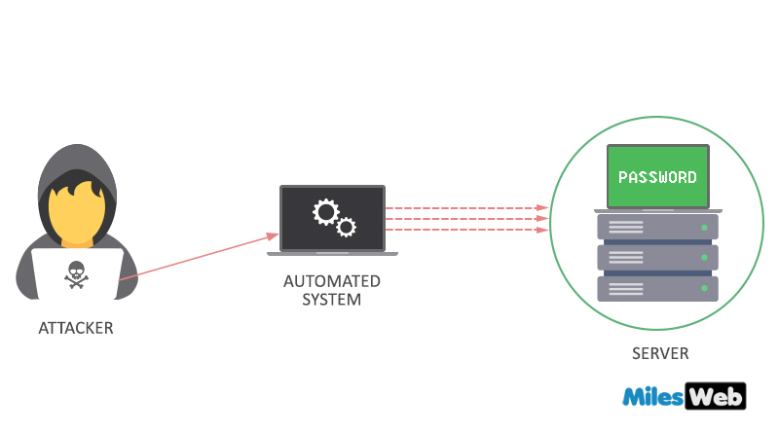


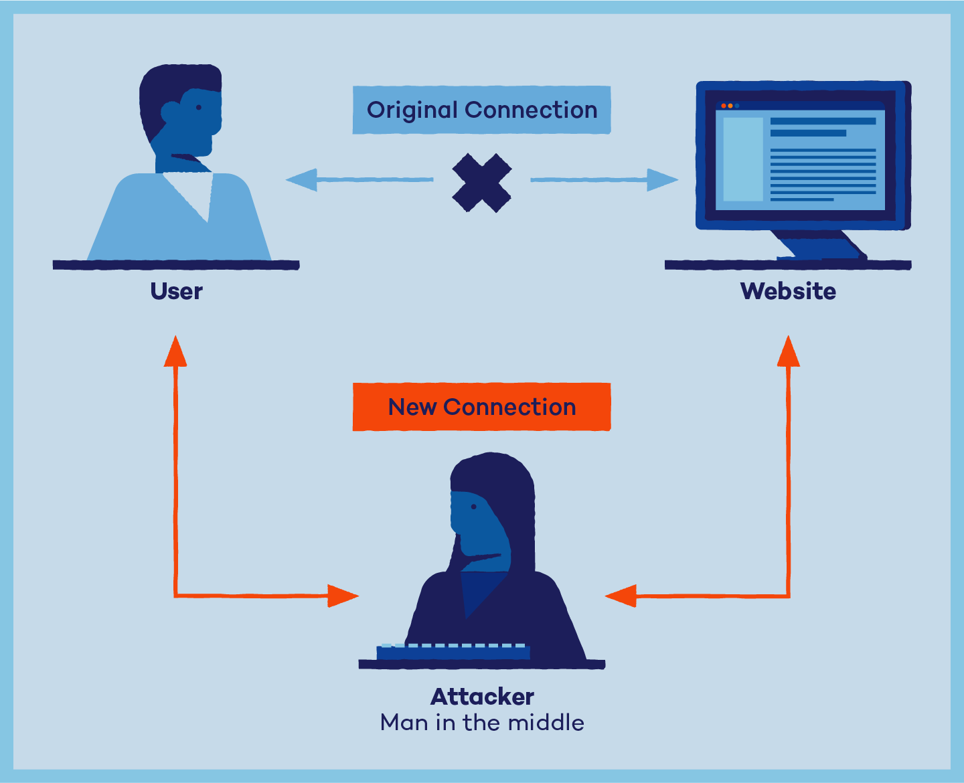
METHODOLOGY

Slide 17
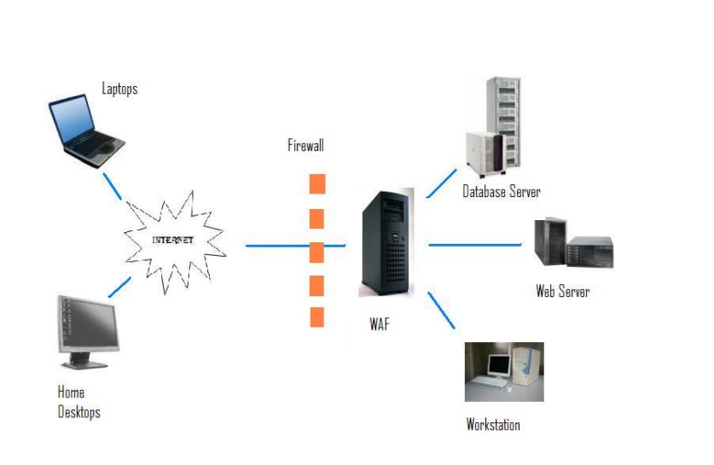
METHODOLOGY
Deployment of a WAF

Slide 18
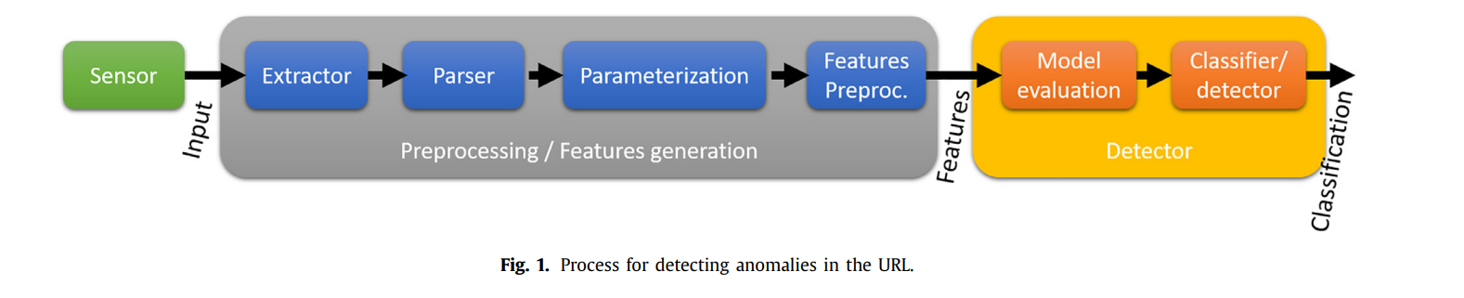
METHODOLOGY
I. HTTP request Prolifering:

Slide 19

METHODOLOGY
01
02
03
04
Sensor produces the observation of the HTTP request used as the input for the detection system.
Extract the actual data of interest from the observation of sensor. Like URI, cookies, response codes,
Parser extracts output from extractor. It breaks down the URI into its constituent fields, protocol version, etc.
Parameterization analyzes output of parser, by analyzing its properties by assessing probabilities, identifying patterns or n-grammars.

Slide 20
METHODOLOGY
05
06
07
Preprocessing reduces complexity of previous step through techniques like Principal Component Analysis (PCA), clustering, etc.
Model Evaluation evaluates the input according to a model pre-established and obtain metrics related to similarity wrt to model of normality.
Classifier finalizes the decision based on the previous metrics.

Slide 21
METHODOLOGY
The WAF detects and mitigates web attacks in real time after HTTP request examining.
If the user profile associated with the request is benign and a static page has been requested then will be opened without triggering otherwise malicious requests would be blocked and sent for further analysis.

Slide 22
METHODOLOGY
II. Bot Scanning:
The request prolifered is first passed through a bot and scanning detection engine analyzes with respect to time, requested URL and socket information of requester.
The WAF after analyzing the HTTP request then, performs some basic built in checks.
These are basically hard coded in the module. It includes the complicated validations such as URL encoding validations and Unicode encoding validations.

Slide 23
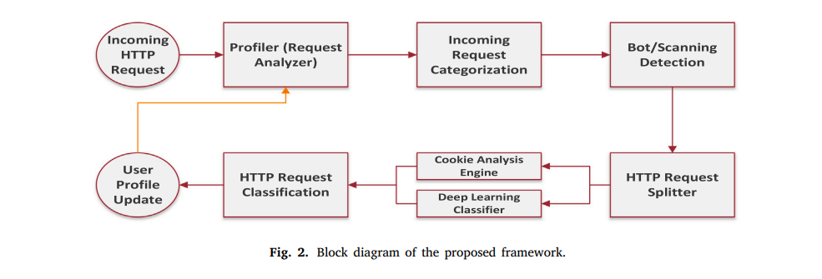
METHODOLOGY
If a bot or scanner is detected, the request is turned down and user will be profiled malicious.
Furthermore for more security, the request is split in a way that the cookies are analyzed by the Cookie Analysis Engine and other HTTP parameters go to the deep learning classifier for further analysis.

Slide 24
METHODOLOGY
III. Execute matching of rules:
Rules are expressed as Regular Expressions.
Each rule represents a certain type of threat which the administrator thinks to be vulnerable to the system.
Each rule is compared with the info. from the packet. If it matches the packet is blocked by closing the socket connection.
Eg. Filter REMOTE ADDR ‘‘203.200.95.130’’ | REQUEST FILENAME ‘‘/bin/sh’’ ‘‘deny.

Slide 25
METHODOLOGY
IV. Logging :
It is an important part of a web application.
Logs are maintained from both sides, from client to server and back from server to client.
. A total of 18 fields like protocol, source/destination IP address, source/destination port number, method, response status, time, etc. is being logged.
Thereafter, log files are trained using the Clustering Algorithms to detect an intrusion in the system.

Slide 26
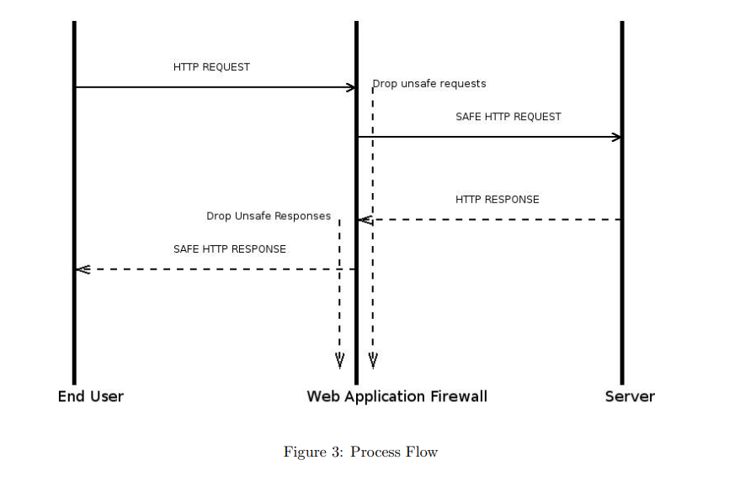
METHODOLOGY
Process Flow:

Slide 27
METHODOLOGY
Clustering Algorithms :
The clustering algorithms use the dataset to form clusters and detect intrusions. Almost all of them work on the following two assumptions:
1. The normal instances have similar properties and occur close together to form one single cluster while anomalies are far apart from them.
2. The number of normal instances are exceedingly large than the number of anomalies i.e. normal instances constitute around 95-98 % of the total data while anomalies constitute the rest.

Slide 28
METHODOLOGY
Clustering Algorithms :
Types of Clustering Algorithms :
1. Leonid Portnoy Algorithm
2. K Means Algorithm

Slide 29
Comparison of WAFs
METHODOLOGY
WAF | Deployment | Key Features | Strengths | Weakness
Akamai Kona Site Defender | Cloud-based | Global CDN, DDoS protection, bot mitigation | Extensive global network, scalability | Potentially higher cost, may have a learning curve
Imperva WAF | Cloud-based & On-premises | Bot mitigation, database security, CDN integration | Comprehensive security features, flexible deployment | Cost can be a concern for some smaller organizations
Cloudflare WAF | Cloud-based | Integrated CDN, performance optimization | CDN-enhanced security, cost-effective | Some advanced features may require additional fees
F5 Networks WAF | Cloud-based & On-premises | Load balancing, application security, advanced threat protection | Integration with Fortinet Security Fabric, security expertise | Complexity in configuration, may require specialized skills

Slide 30






APPLICATIONS
01.
02.
03.
Protect Web Apps:
WAFs are primarily used to safeguard web applications from a wide range of online threats, including SQL injection, cross-site scripting (XSS), and other common attacks.
DDoS Mitigation :
WAFs often include DDoS protection capabilities, helping to mitigate and minimize the impact of distributed denial of service attacks on web applications.
Security:
WAFs are used to achieve regulatory compliance (e.g., PCI DSS) by adding an additional layer of security to web applications, ensuring data protection and privacy.

Slide 31
APPLICATIONS
04.
05.
Application layer security:
They protect the application layer of web services, enhancing security by detecting and blocking malicious traffic before it reaches the application.
Bot Mitigation :
WAFs can identify and block malicious bots, ensuring that web applications are not exploited by automated scripts for fraudulent purposes.

Slide 32

ADVANTAGES
Protection from Web Attacks: WAFs prevent common web attacks like SQL injection and XSS, enhancing web application security.
Traffic Inspection: They inspect incoming and outgoing web traffic, allowing for real-time threat detection and blocking.
Compliance Assistance: WAFs help organizations achieve regulatory compliance, such as PCI DSS, by providing a layer of security.
DDoS Mitigation: Many WAFs offer DDoS protection, safeguarding against distributed denial of service attacks and ensuring web application availability.

Slide 33
DISADVANTAGES
False Positives: WAFs can generate false positive alerts, potentially blocking legitimate traffic and causing disruptions.
Complex Configuration: Configuring WAF rules can be complex, requiring expertise to fine-tune settings effectively.
Resource Overhead: Implementing WAFs can introduce latency and consume server resources, impacting application performance.
Cost: Some WAF solutions can be costly, especially for organizations with limited budgets, leading to increased operational expenses.

Slide 34
CONCLUSION
Study and analysis of Web Application Firewalls (WAFs) have provided valuable insights into these essential security tools.
We have delved into their working principles, understanding how they serve as a crucial defense mechanism against web-based threats.
Moreover, we conducted a comprehensive comparison of various WAF providers, shedding light on the diverse features, deployment options, and strengths of these solutions.
This knowledge equips us with the understanding needed to make informed decisions when it comes to selecting and implementing WAFs, ensuring the security and integrity of web applications in an ever-evolving digital landscape.

Slide 35
REFERENCES
Elsevier Journals :
1. “A critical review of the techniques used for anomaly detection of HTTP-based attacks: taxonomy, limitations and open challenges.”
2. “A deep learning assisted personalized deception system for countering web application attacks.”
3. “An enhanced deep learning based framework for web attacks detection, mitigation and attacker profiling .”
4. “ An enhanced deep learning based framework for web attacks detection, mitigation and attacker profiling .”
5. “ Dynamic Web Application Firewall detection supported by Cyber Mimic Defense approach.”
6. “HTTP request pattern based signatures for early application layer DDoS detection: A firewall agnostic approach.”
7. “Hybrid unsupervised web-attack detection and classification – A deep learning approach.”

Slide 36
REFERENCES
Elsevier Journals :
8. “Signature based and Machine learning based WAF : A Short Survey.”
9. “Software defined network-based HTTP flooding attack defender.”
IIT Kharagpur CSE Project Report : “WEB APPLICATION FIREWALL Study”.
Online Resources :
1. https://www.fortinet.com/resources/cyberglossary/waf-vs-firewall
2. https://www.cloudflare.com/learning/ddos/glossary/web-application-firewall-waf/
3. https://owasp.org/www-pdf-archive/APAC13_Jaeson_Yoo.pdf
4. https://www.researchgate.net/publication/226351120_Learning_Web_Application_Firewall_-_Benefits_and_Caveats
5. https://www.sciencedirect.com/
6. https://www.cse.iitk.ac.in/users/dheeraj/btech/namitg+abakashs.pdf

Slide 37
THANK YOU!

